Slide 1
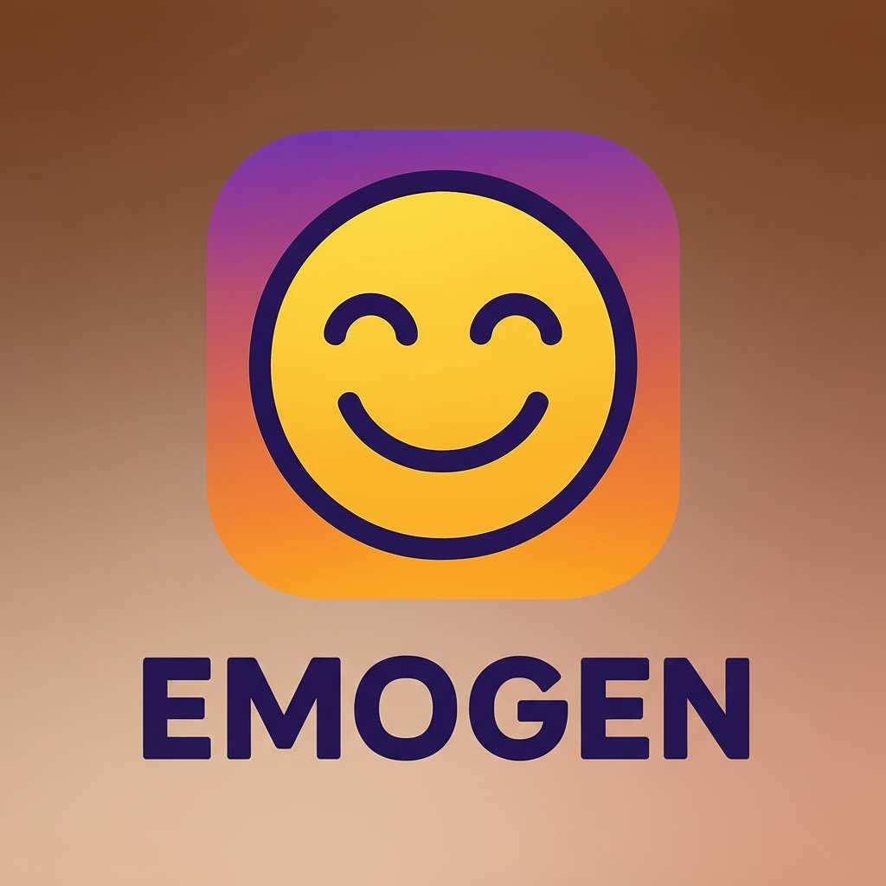
EmoGen: Mood-Based Emoji Generator
Submitted By:
Sannidhi Mutyala(25030422075)
Patlolla Shloka Reddy(25030422083)
Vepuri Dheeraj(25030422131)
Notes:
1.7.2013
1.7.2013
1
‹#›
‹#›

Slide 2


Project Abstract: Bridging Emotion and Code
This project develops a simple Python application that translates user-inputted emotional keywords into relevant visual emojis, aiming to enhance the emotional context of digital communication.
It serves as a foundational exercise in basic data structures (dictionaries) and conditional logic in Python.
Notes:
1.7.2013
1.7.2013
2
‹#›
‹#›

Slide 3

Defining the Problem: The Lack of Emotional Context
Monolithic Text
Ambiguity in Communication
Engagement Deficiency
Traditional programs and text interfaces often lack the ability to convey subtle emotional nuances.
Unexpressive interfaces reduce user engagement and make interactions feel impersonal or mechanical.
Plain text can lead to misinterpretation of the sender's actual tone or feeling.
The challenge is creating a simple system to inject immediate visual emotion into digital inputs.
Notes:
1.7.2013
1.7.2013
3
‹#›
‹#›

Slide 4
Project Objectives
Master Basic Python Constructs
Develop a Functional Mapping
1
2
To effectively utilise dictionaries, loops and functions for mapping and conditional statements for matching moods.
To create a robust dictionary that accurately links common mood keywords to specific Unicode emojis.
Ensure User-Friendly Input
Generate Relevant Output
3
4
To handle variations in user input (e.g., case insensitivity) for a seamless experience.
To output the corresponding emoji or a default response if the mood is not recognised.
Notes:
1.7.2013
1.7.2013
4
‹#›
‹#›

Slide 5



Significance of the Project
Visual Communication
1
Demonstrates how code can add visual depth to textual data.
User Experience
2
Improves user interaction by making the output immediate and expressive.
Foundational AI Concept
3
An example of rule-based artificial intelligence .
Notes:
1.7.2013
1.7.2013
5
‹#›
‹#›

Slide 6





Tools and Technologies Used
Python 3.x
Core programming language for implementing the logic and data structures.
Google Colab
Integrated Development Environment (IDE) for writing, debugging, and executing the Python script.
GitHub
Version control and repository for uploading the project code.
Emoji Unicode
Source for the specific character codes needed to display emojis in the output.
Notes:
1.7.2013
1.7.2013
6
‹#›
‹#›

Slide 7





Project Overview: How it Works
User Input
User enters a word describing their current mood (e.g., "excited").
Dictionary Mapping
The program searches the input in the predefined mood-to-emoji dictionary.
Emoji Output
If a match is found, the corresponding emoji is printed to the console.
Example: Input 'sad' → Match 'sad' in dictionary → Output '😢'
Notes:
1.7.2013
1.7.2013
7
‹#›
‹#›

Slide 8






System Flow Diagram
Output Emoji
Start
User Input
Match Mood
End
The linear flow ensures quick processing and a defined outcome for every user interaction.
Notes:
1.7.2013
1.7.2013
8
‹#›
‹#›

Slide 9
Algorithm: The Step-by-Step Logic
Initialise Dictionary
Prompt User
Sanitise Input
Define a key-value dictionary mapping mood strings (keys) to emoji characters (values).
Ask the user to input a single word representing their mood.
Convert the user input to lowercase to ensure case-insensitive matching.
Check Dictionary
Display Match
Display Default
Use a conditional statement (if/else) to check if the processed input exists as a key.
If the key is found, retrieve and print the associated emoji value.
If the key is not found, print a message indicating no match was located.
Notes:
1.7.2013
1.7.2013
9
‹#›
‹#›

Slide 10

Code Explanation: Data Structure and Input
The Mood Dictionary
This is the core of the project, defining the universe of emotions the generator can understand.
Uses Python's dict data type.
Keys are simple mood strings (e.g., 'happy', 'angry').
Values are the Unicode emoji characters.
User Interaction
The input() function captures the user's current mood.
Prompts for input text.
Stores the result in a variable for processing.
Notes:
1.7.2013
1.7.2013
10
‹#›
‹#›

Slide 11
Code Explanation: Logic and Processing
Conditional Logic & Input Processing
# Process user input for case-insensitivityuser_mood = input("How are you feeling today? ").lower()# Conditional logic for mood processingif user_mood in mood_mapping: emoji = mood_mapping[user_mood] print(f"You're feeling {user_mood}? Here's an emoji: {emoji}")else: print("Sorry, I don't have an emoji for that mood yet.")
After capturing user input, the program needs to determine if the entered mood is recognized.
An if/else statement checks if the user's mood exists as a key in the mood_mapping dictionary.
The .lower() string method is applied to the user's input to ensure case-insensitivity, making the comparison robust (e.g., 'Happy' becomes 'happy').
Output Handling
Based on the conditional check, the program provides feedback to the user.
If the mood is found, the corresponding emoji from the dictionary is retrieved and displayed.
If the mood is not found, a polite message informs the user that the mood is not recognized.
Notes:
1.7.2013
1.7.2013
11
‹#›
‹#›

Slide 12



Sample Outputs: Demonstrating the Generator
Input: "happy"
Input: "sad"
Output: "You're feeling happy? Here's an emoji: 😊"
Output: "You're feeling sad? Here's an emoji: 😢"
Input: "excited"
Input: "confused"
Output: "You're feeling excited? Here's an emoji: 🎉"
Output: "Sorry, I don't have an emoji for that mood yet."
Notes:
1.7.2013
1.7.2013
12
‹#›
‹#›

Slide 13
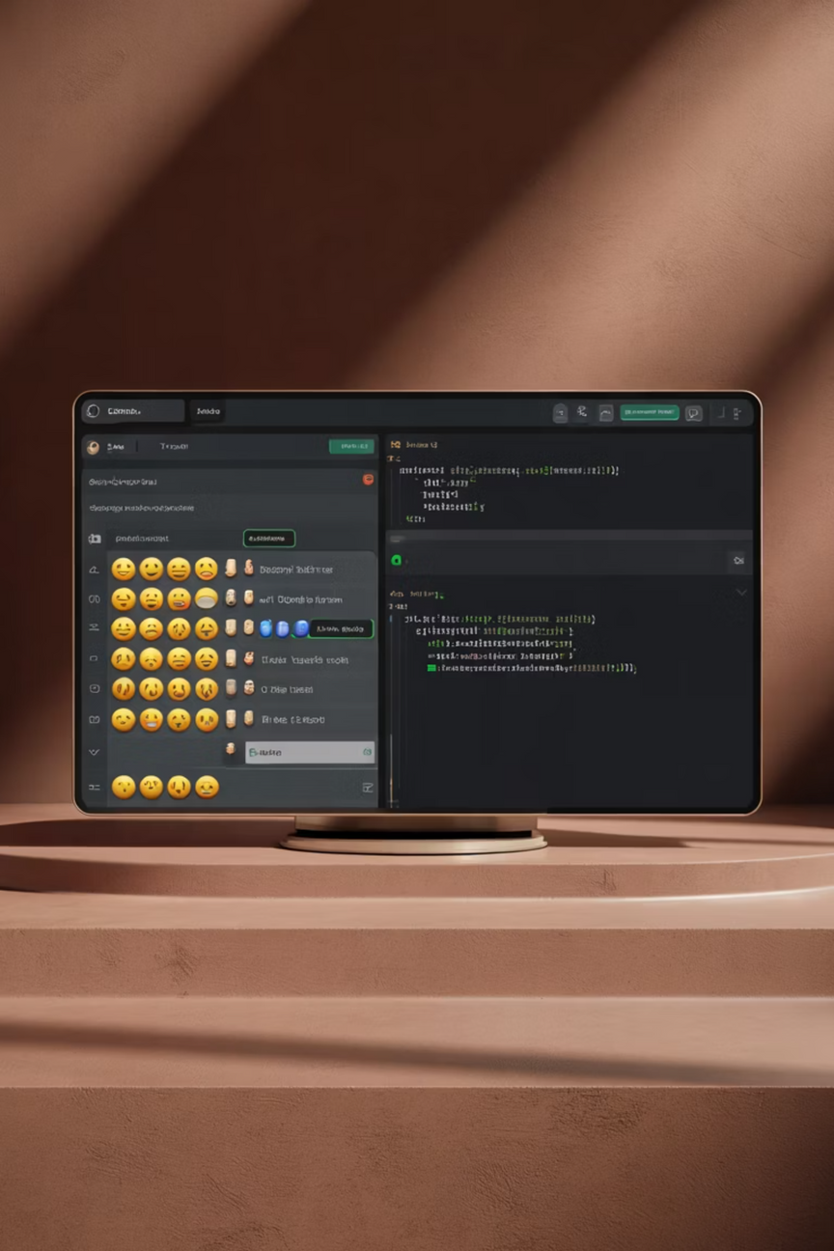
Key Features
Case-insensitive input handling
Dictionary-based mood mapping
Real-time emoji output
User-friendly error messages
Simple console interface
Extensible mood database
Unicode emoji support
Notes:
1.7.2013
1.7.2013
13
‹#›
‹#›

Slide 14
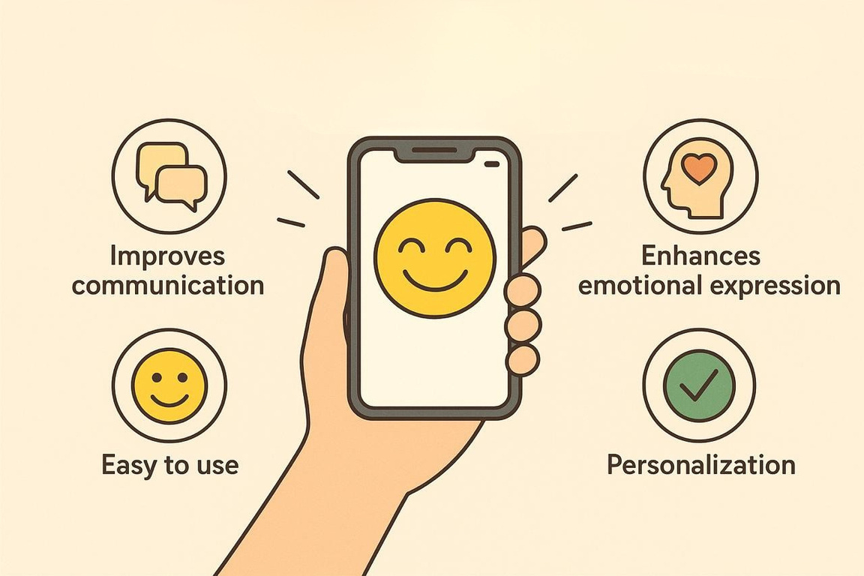
Advantages
Enhanced digital communication through visual emotion
Simple and intuitive user interface
Educational value for learning Python fundamentals
Foundation for advanced NLP applications
Cross-platform compatibility
Notes:
1.7.2013
1.7.2013
14
‹#›
‹#›

Slide 15






Real-World Applications
Social Media Platforms
Customer Service Chatbots
Integrate for automatic emoji suggestions based on user sentiment in posts and comments.
Enable chatbots to detect and respond to emotional context, improving user interactions.
Mental Health Apps
Educational Tools
Utilize for mood tracking and providing emotional insights to users.
Develop for teaching emotional intelligence and recognizing feelings in text.
Communication Platforms
Marketing Tools
Enhance messaging with real-time emotional feedback and appropriate emoji enhancements.
Apply for sentiment analysis of customer feedback, reviews, and social media trends.
Notes:
1.7.2013
1.7.2013
15
‹#›
‹#›

Slide 16

Limitations
Limited Mood Vocabulary
Lack of Contextual Understanding
Simple Pattern Matching Approach
The current model relies on a predefined and somewhat narrow vocabulary of moods, which may not capture the full spectrum of human emotions or nuanced expressions.
The generator struggles with sarcasm, irony, and complex figurative language, often misinterpreting emotional intent without broader conversational context.
Its reliance on basic keyword and pattern matching can lead to generic or inaccurate emoji suggestions for more complex or subtle emotional statements.
Notes:
1.7.2013
1.7.2013
16
‹#›
‹#›

Slide 17
Thank you

